Slide 1
WELCOME
WELCOME GNIOT TECH CLUB, HACKATHON

Slide 2
Notes++ for students
GLOBAL
WORLD MAPS
BRAZIL
In Brazil
USA
in the United States
ASIA
In Asia
RUSSIA
In Russia

Slide 3
Notes++ for students
N++
Take your notes anywhere, anytime

Slide 4
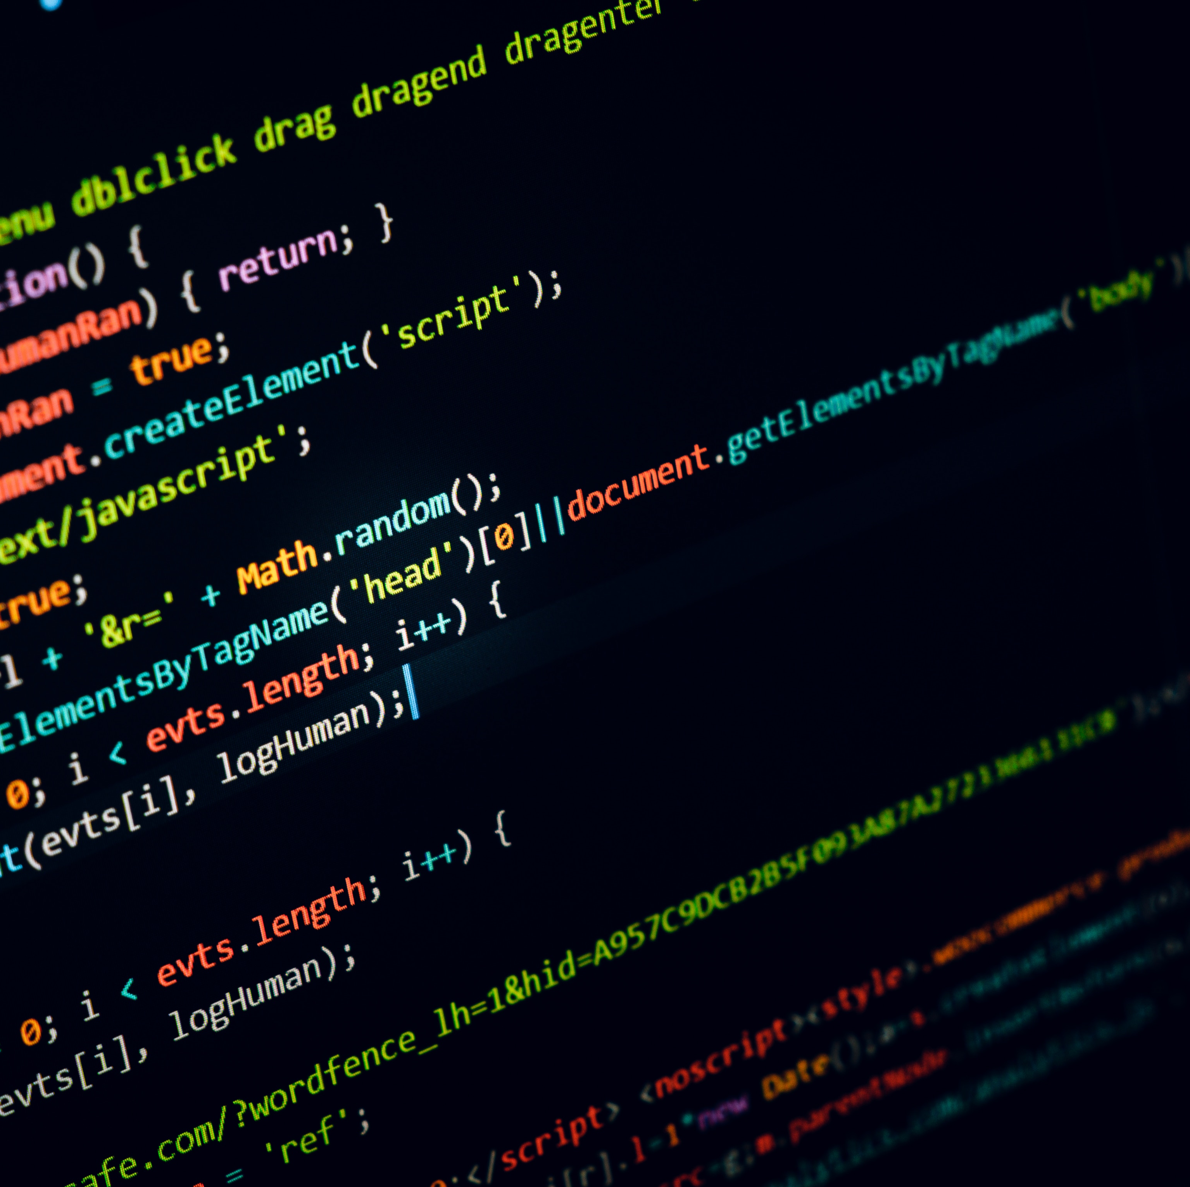
Notes++ for students
Notes++
This is all in one solution for students
It provides the whole documented information of the notes prepared live in the class by teachers own language.
It uses artificial intelligence for preparing points like
Uses natural language processing for getting sentiments from the text and making the points or topic of the day
Uses live speech to text or text to speech transformation for converting sounds into text
It used
LEARN EXtRA

Slide 5

TTM
Notes++ comprises of full capabilities of convincing you in a most advanced futuristic manner
Full Control over teachers content
Using advance artificial intelligence API’S to retrieve the information
Uses Tone Analyzer to insert special smillies
Uses Language Translator
Uses Natural Language Processing (NLP) and python natural language toolkit (NLTK)
Uses special recognition over language for inserting relevant pictures in the notes
N++
Note++
For Students

Slide 6
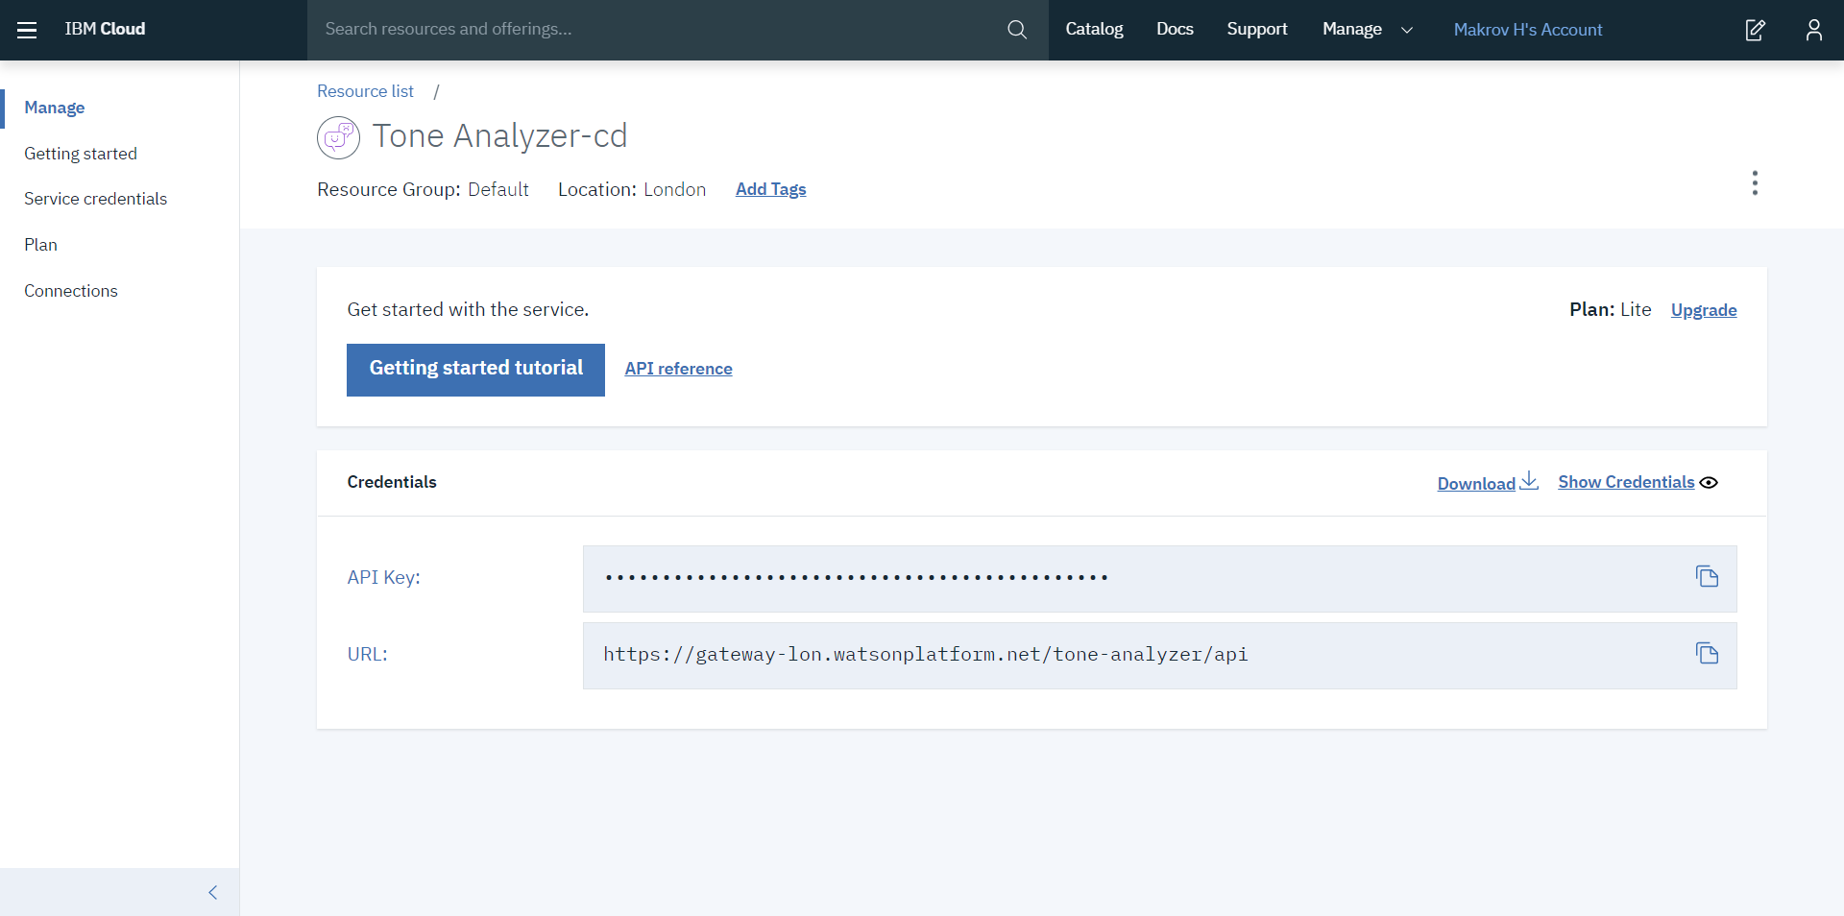
Notes++ for students
Tone Analyzer
T
For understanding in teachers sound
emotion (anger, disgust, fear, joy and sadness)
Social Propensities (openness, conscientiousness, extroversion, agreeableness and emotional range)
Language style(analytical, confident)
N++

Slide 7
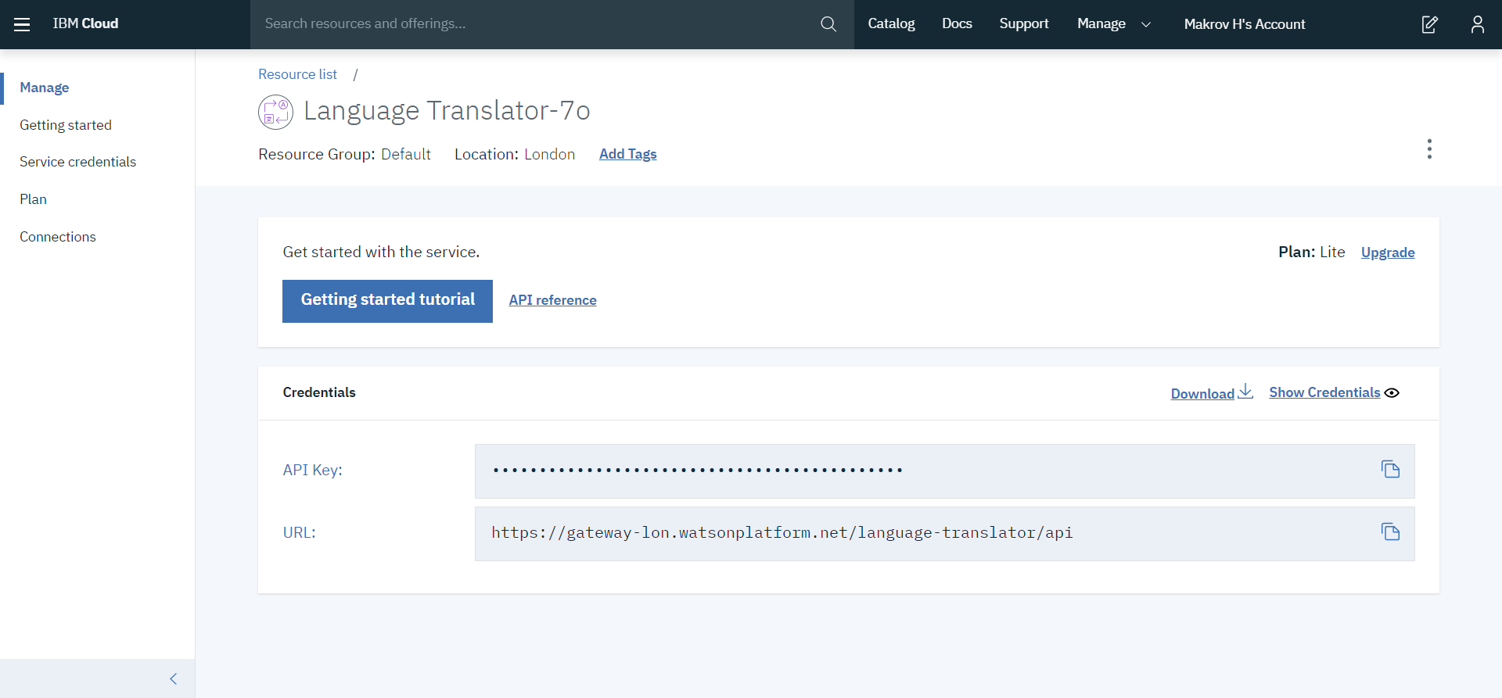
Notes++
Language Translator
L
It’ translate to your own specific so that it can be used globally
N++

Slide 8
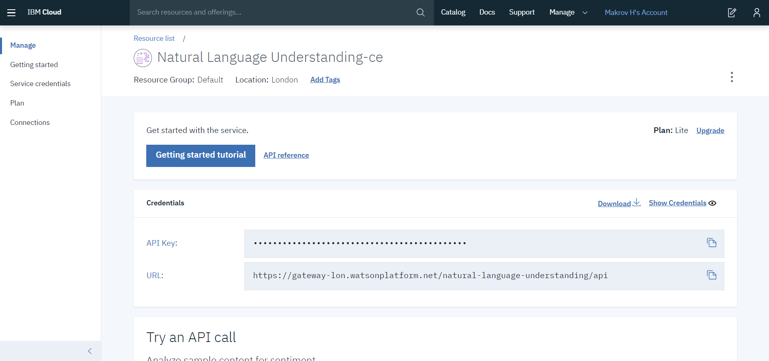
Notes++
Natural Language Processing (NLP)
N
For retrieving content such as concepts, entities, keywords, categories, sentiments, emotions, relations
Uses natural language processing for inserting specific pictures in the relevent notes
N++

Slide 9
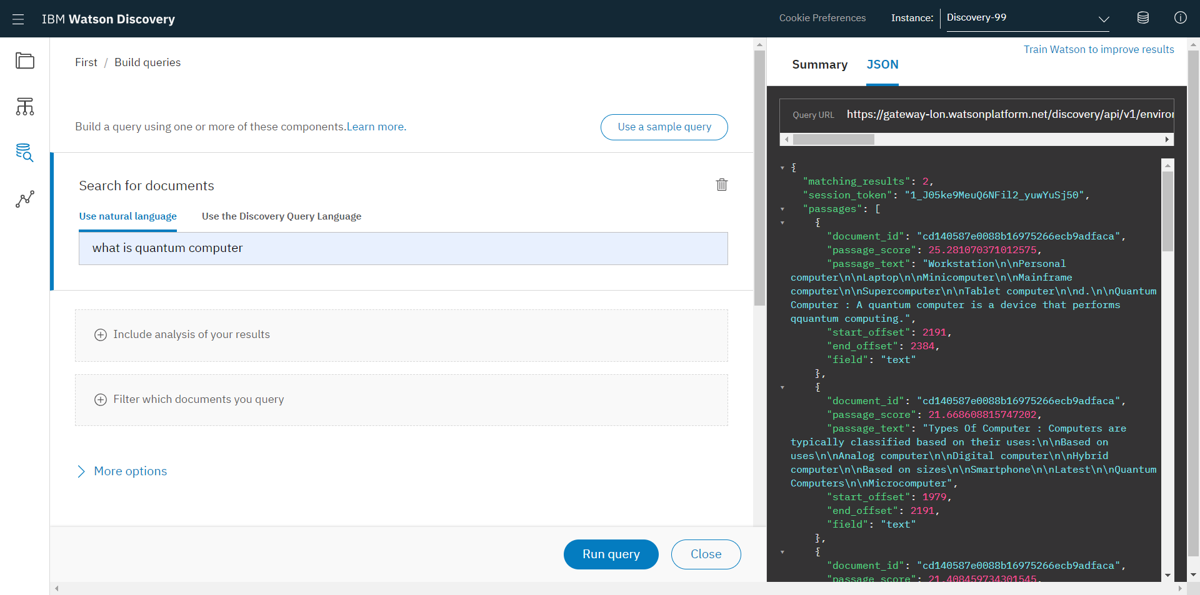
Notes++
Q&A with Watson Discovery
Q
If you are finally analyzing all of the text, still if you are unable to find the insights then try this one
You can search any question in your mind as a natural language and get the appropriate relevant answer according to that.
N++

